Slide 1
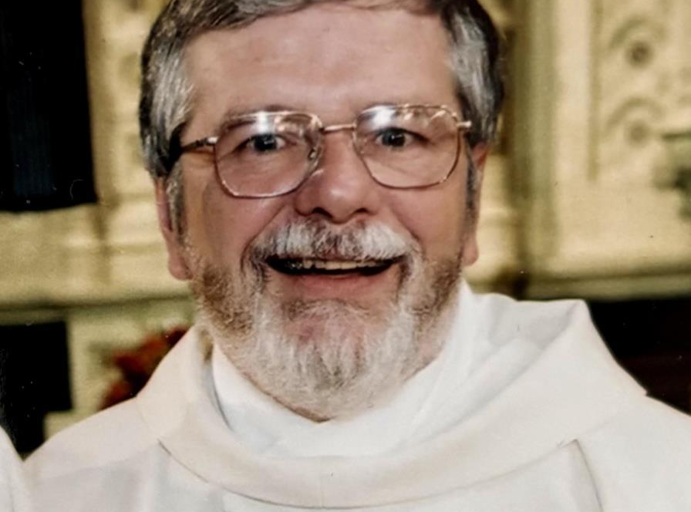
A Legacy of Homilies
Francis “Deacon Frank” Tremblay
Sept 11, 1949 – January 31, 2025

Slide 2
The Homilies of Deacon Frank
In his 20 years as an ordained Deacon of the Roman Catholic Church, Deacon Frank’s greatest passion and his greatest gift was sharing the Word of the Lord.
Before Frank returned to the Lord, we are fortunate that he was able to share his saved speaking notes for almost 500 sermons that he delivered through the years. Some of these sermons were delivered to an overflowing church on Easter Sunday. Others were delivered to a bare handful at a makeshift Mass in a small classroom while on mission in the Bahamas. However, all of these sermons were delivered with a passion to share the Word of God with any that would listen.
This is a record of the speaking notes Deacon Frank made for himself to present his homilies. We unfortunately do not have any recordings or transcripts that would give us the gift of hearing his voice. What we do have are the speaking notes he used to share the insights he offered into the Readings of the day.
While we can not hear the stories Deacon Frank told us on Sunday’s, hopefully the opportunity to see into his speaking notes will provide you with a chance to gain an insight into that day’s Readings that you may not have had. Deacon Frank’s personal notes are provided here for all to have an opportunity to continue to learn from his unique way of spreading The Word.

Slide 3
Obituary for Deacon Francis "Frank" R. Tremblay
TREMBLAY, FRANCIS R. “Deacon Frank” of Stoughton passed away on January 31, 2025 at the age of 75. Beloved husband of the late Virginia “Ginni” M. (Caldwell) Tremblay. Devoted father of Matthew D. Tremblay and his wife Melissa of Kingwood, TX, Michael F. Tremblay and his wife Catherine of East Hampton, NY and Joseph D. Tremblay and his wife Liza of Sag Harbor, NY. Brother of Rosanna Kenney of Dracut and Mary Burke of Methuen. Cherished grandfather of Jack Christopher Tremblay, Leo John Tremblay, Rose W. Tremblay and Henri S. Tremblay. Also survived by many nieces and nephews. Son of the late Leo J. and Gloria A. (Boucher) Tremblay. Frank was a proud graduate of Boston College and had a long career in technology while living with his family in Canton, MA. Always a devout Catholic, Frank was an active member of the New Jerusalem Charismatic Prayer Group, meeting at St. Timothy’s Parish in Norwood for 40 years. In 2002 he was ordained a Deacon and transitioned from a career in technology to managing the Sacred Hearts Retreat Center in Wareham. Upon retiring, Frank and his wife Ginni moved to Andros Island in the Bahamas where they established a Catholic ministry and served the community for seven years. They were forced to return to the US when Ginni began to show the signs of Alzheimer’s and Frank cared for her at their home in Stoughton for many years while ministering at Our Lady of Sorrows in Sharon, the Chaplain at the Nassau Street Jail, and finally as deacon at St. Catherine’s of Siena in Norwood. He was blessed to live a life touched by many wonderful friends and was especially fortunate to have found Dr. Marjorie Goodwin who was a cherished companion after the death of his wife and supported him through his battle with cancer.

Slide 4
Please click on the link below to access the available notes from that Mass.
Homilies are listed by the week of the Liturgical Calendar.
When Available, the year of the Calendar (A, B, C) can be identified by the file name. For some years, multiple homilies are available.
The Liturgical Cycle begins on the 1st week of advent each year.
Advent 2024 – 2025 YEAR C
Advent 2025 – 2026 YEAR A
Advent 2026 – 2027 YEAR B
ADVENT | CHRISTMAS TIME | ORDINARY TIME |  | FEAST DAYS | LENT/EASTER | OTHERS
Advent 1 | Holy Family | 2nd | 19th | Presentation of the Lord | Ash Wednesday | Asumption
Advent 2 | Epiphany | 3rd | 20th | Pentacost Vigil | 1st Sunday of Lent | Birth of John the Baptist
Advent 3 | Baptism of Lord | 4th | 21st | Pentacost Sunday | 2nd Sunday Of Lent | Funerals
Advent 4 | Christmas | 5th | 22nd | The Most Holy Trinity | 3rd Sunday of Lent | Mary Mother of God
 | Christmas Midnight | 6th | 23rd | Corpus Christi | 4th Sunday of Lent | Sacred Heart
 | Christmas Dawn | 7th | 24th | Saints Peter & Paul | 5th Sunday | Thanksgiving
 | Christmas Vigil | 8th | 25th | Exaltation of the Holy Cross | Holy Thursday | Transfiguration
 |  | 9th | 26th | All Souls Day | Good Friday
 |  | 10th | 27th | OLJC, King of the Universe | Holy Saturday
 |  | 11th | 28th | All Saints Day | Palm Sunday
 |  | 12th | 29th |  | Easter Sunday
 |  | 13th | 30th |  | 2nd Sunday of Easter
 |  | 14th | 31st |  | 3rd Sunday of Easter
 |  | 15th | 32nd |  | 4th Sunday of Easter
 |  | 16th | 33rd |  | 5th Sunday of Easter
 |  | 17th | 34th |  | 6th Sunday of Easter
 |  | 18th |  |  | 7th Sunday of Easter
 |  |  |  |  | Ascension Sunday

